Slide 1
POLS 207
State & Local Government*
Chapter 10A
Executing the Laws and Leading the People
Dr. Roblyer, Ph.D.
*These slides are based on originals provided by Dr. Harvey Tucker

Slide 2
Learning Objectives
Characterize the similarities and differences in the professional and political backgrounds of Texas governors from 1979 until today.
Describe the incumbent advantage in gubernatorial races.
Explain how governors are becoming increasingly powerful on the national political stage.
Discuss what governors do after they leave office and why.
Describe the power that governors wield, breaking it out by types and subtypes, and providing examples of each. Discuss how Texas governors are empowered or not.
Explain how different states and different governors wield different amounts and types of power. Discuss the distribution of gubernatorial power across the states, pinpointing where Texas lies. Describe the measure used.
Explain the term “plural executive,” its origin, and what it means for political power in Texas.

Slide 3
Approach to this Chapter
Governor – Texas Style
Plural Executive – Mavericks Loose on the Range
  Lieutenant Governor – Biggest Hombre in Tejas
  Other powerful state-wide-elected officials
Bureaucracy – Blossoming under “Small Government” fertilizer

Slide 4
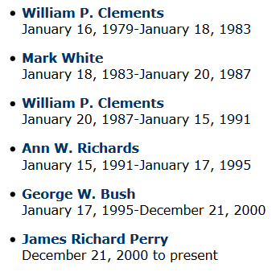
Recruitment of Governors
Governors come with considerable prior experience in public affairs
“Promotion” from other statewide elective office is common, but is not a rule
DepSecDef, U.S. Dept of Defense
TX Sec of State, Attorney General
DepSecDef, U.S. Dept of Defense
TX Treasurer
(1 failed run for Congress)
TX House, Ag Commissioner, Lt. Gov
Greg Abbott
TX Supreme Court, Attorney General
Notes:
2006 Perry
2002 Perry
1998 Bush
1994 bush
1990 Richards
1986 Clements
1982 white
1978 Clements
1974 Briscoe

Slide 5
Recruitment of Governors
Most are lawyers, but many come out of business backgrounds (sometimes both)
Oil
Lawyer
Oil
Teacher, political volunteer
Oil, Texas Rangers team co-owner
Farmer, rancher
Greg Abbott
Lawyer
Notes:
2006 Perry
2002 Perry
1998 Bush
1994 bush
1990 Richards
1986 Clements
1982 white
1978 Clements
1974 Briscoe

Slide 6
US Gubernatorial Elections
Always partisan, always contested
  Almost always “competitive” (60-40 or tighter)
Incumbent advantage is real phenomenon for modern governors
  1950s: +2% more votes than opponents
  1990s: +11% more votes than opponents
  In 2010: 11 sitting governors sought re-election
    All but 2 won their contest

Slide 7
Governorships are Growing in Power
Nationwide trend
  State governments playing larger role
    Governors frequently advocate for more of that role to be handled by states
  Growth in state government has occurred within executive branch, which is led by governor
  Executive branch leadership is pertinent experience because it is composed of full-time, professional, experienced staff
    In comparison, Legislature is part-time, amateur, lay
  Media loves a face—focuses on key personalities
…as long as the feds pay the bill!
…and governors love to fill that need!

Slide 8
Governor’s Careers
Governors are often more politically ambitious than other state & local officials
  Although most governors do retire after leaving office
Not everyone can become President, so those who remain in public service often seek other government “promotions”
  Appointment to federal Cabinet post (20%)
  Run for U.S. Senate (15%)
  Appointment as federal judge (5%)

Slide 9
Gubernatorial Power
Two components
  Institutional
    Given by state’s Constitution
    Five types
  Personal
    Varies with the person & circumstance
Defies expectations of most Texans
  Institutional – Weaker than expected
  Personal – Stronger than expected
Sometimes referred to as formal and informal powers

Slide 10
Institutional Power - Types
Appointment
Tenure Potential
Managerial
Fiscal
Legislative
POLS term that means “arising from structure, organization, and rules”
Not dependent on unique personal characteristics of a governor

Slide 11
Institutional Power #1
Appointment
  Power to choose other statewide executive officials
    Although state senate must confirm most gubernatorial appointments by 2/3rds majority
  Key factor in determining “strength” of governor position in each state
  Texas among weakest: state constitution requires many statewide positions be elected instead

Slide 12
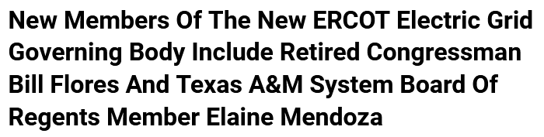
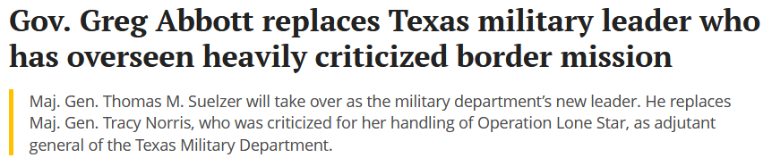
Institutional Power #1
Appointment
(These are indirect appointments—the governor
picked the committee that picked these folks)
https://www.cnn.com/2021/10/21/politics/texas-secretary-of-state/index.html
https://www.texastribune.org/2022/03/14/texas-greg-abbott-border-military-thomas-suelzer/

Slide 13
Institutional Power #2
Tenure Potential
  Ability to remain in office, including any
  re-election restrictions
  Vary widely across states
    Length of terms
    Maximum number of consecutive terms
    Maximum number of non-consecutive terms
  Few governors serve more than 8 years
    Gov. Perry began serving in 2000, was first elected in 2002, served until 2014

Slide 14
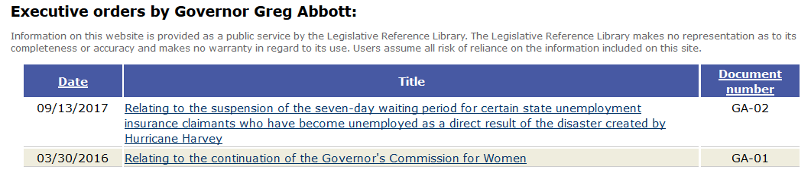
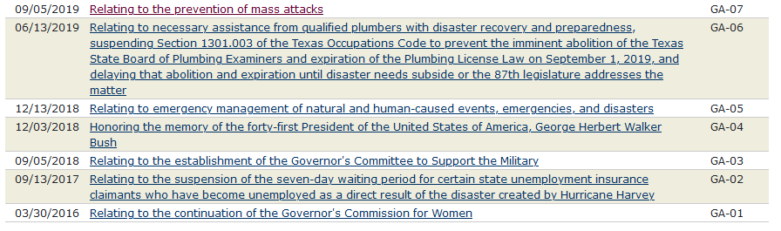
Institutional Power #3
Managerial
  Oversight of administration
  Coordination
  Executive orders direct agents in executive branch
    In Texas: January 2016 to March 2020
    not frequent or far-reaching
http://www.lrl.state.tx.us/legeLeaders/governors/displayDocs.cfm?govdoctypeID=5&governorID=45

Slide 15
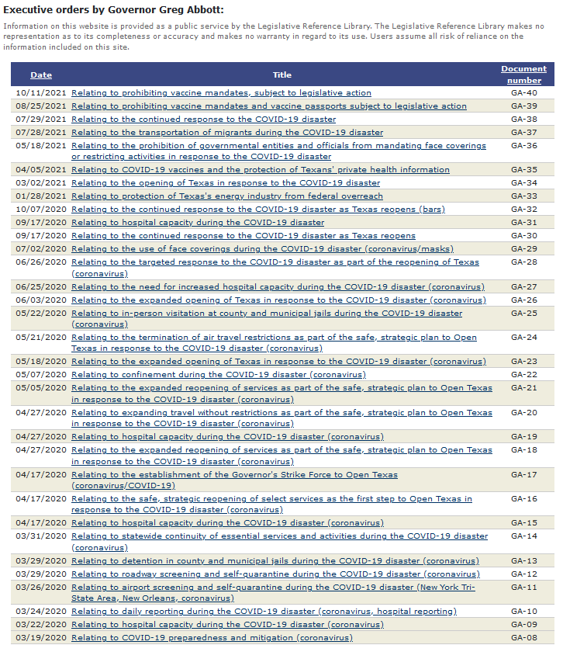
  Executive orders
    In Texas: FROM March 2020 TO Oct 2021
    much more frequent & impactful
    Most were made using governor’s Emergency Powers (applicable during COVID)
    No new executive orders since then!
http://www.lrl.state.tx.us/legeLeaders/governors/displayDocs.cfm?govdoctypeID=5&governorID=45

Slide 16
Institutional Power #3
Managerial (continued)
  Reorganization (of executive branch)
    Only 25 states give these to governors—not Texas
    Powerful tool to improve political control over government
  Timing of appointments
    Board members have overlapping terms—a one-term governor cannot replace entire board
    Example: TAMU System Board of Regents
      9 members, each with 6-year terms (3 terms expire every 2 yrs)
…How?
3 Regents’
Terms End
3 Regents’
Terms End
3 Regents’
Terms End
Governor’s
1st Term
End of
1st Term
Notes:
Student Question: I am unclear on the definition of reorganization.
DAR: Think of a teacher in a classroom. The students are grouped at tables.
If all is going smoothly, the teacher may leave everything as it is.
If one group is struggling, the teacher may move a strong student from another table and either add her or him to the struggling group, or swap out with another student.
If several of the groups are having behavioral issues, the teacher may rearrange several of the groups to try and get a better mix that will produce better performance all around.
If there is one student that continually makes trouble for the teacher, the teacher may remove the student from the group and seat them all alone in order to send a clearer signal of her or his displeasure with the student, as well as to allow the remainder of the student’s old group to perform better.
This kind of thing happens in organizations, too. When leadership is not pleased with performance, they will sometimes shuffle people between offices and/or shuffle offices under bosses. If a boss is “not with the program” and causing problems for leadership, they may reduce the size of that bosses task and personnel, or even assign that boss to a new job they really don’t like.
Reorganization is an expression of power by the teacher in the first example, and by organizational leaders in the real world every day of business and government.

Slide 17
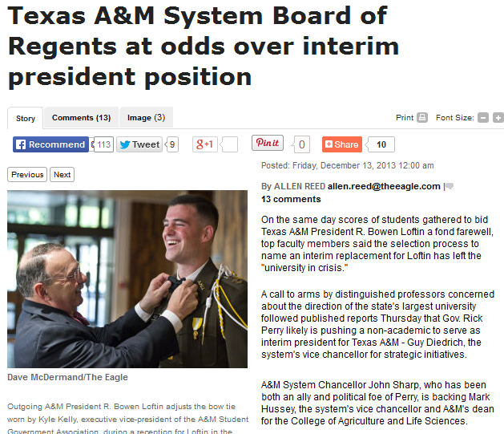
Governor-appointed TAMU System Regents not always in his pocket…
http://www.theeagle.com/news/local/article_f6b65d12-614e-5956-b824-57aafc06dd90.html

Slide 18
Institutional Power #4
Fiscal
  In 48 states, Governor supervises preparation of budget
  Not so in Texas—has weakest fiscal influence
    No formal input to budget content
      Legislative Budget Board (LBB) in charge
      Governor has no appointment power to LBB
    Shares power to transfer money between programs for emergency needs
    Can use veto (see next slide)
    Can use “bully pulpit”
      Try to win battle of public opinion and force LBB into doing something they don’t want to do

Slide 19
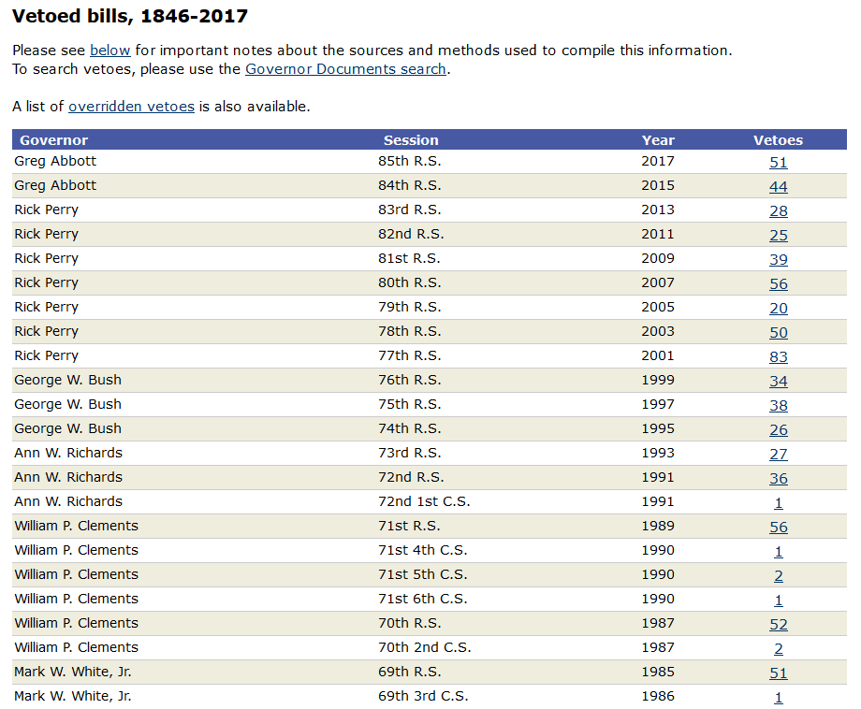
Institutional Power #5
Legislative
  All governors sign bills or can veto them
  Texas governorship is above average: has line-item veto
    Not forced to make “all-or-nothing” decision like U.S. President when considering veto of bill
    Legislature often doesn’t have option to override if already out of session
      Most bills passed at end of session, so Texas gubernatorial vetoes are often final—override is rare (requires 2/3rds majority in both houses)
  Too-frequent or heavy-handed use of veto has been used in past to paint Texas governors as poorly skilled in politics
(a.k.a., a “pick-and-choose” veto)
(abridged)
http://www.lrl.state.tx.us/legis/vetoes/
…still the case?

Slide 20
Institutional Power #5
Legislative (continued)
  Calls special sessions for legislature & sets agenda; legislators limited to that agenda
    No guarantee that legislature will pass any legislation in that special session, much less legislation that governor wants
      However, special sessions are dreaded by legislators—takes money from their pockets by delaying their return to their private lives
    2013: Perry called 3 special sessions in a row to ensure passage of tough, new abortion law and highway funding
…unless the Governor is careless in his/her wording!

Slide 21
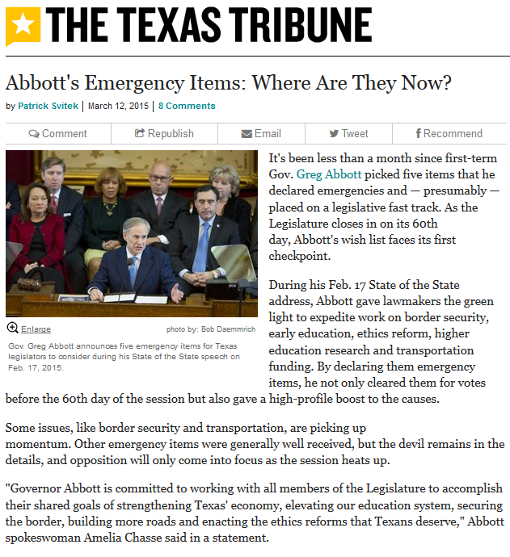
Institutional Power #5
Legislative (continued)
  Declare his/her top-priority issues to be “emergency items” for the legislature
    This designation does not force the legislature to do anything
    “Emergency” status does allow the legislature to vote on related bills during the first half of the session, when such votes are forbidden for other bills
    “Emergency” status does put the prestige of the governor behind those issues (for whatever that may be worth)
  Gov Abbott’s emergency items for 84th Legislature:
    Border security
    Early education
    Ethics reform
    Higher education research
    Transportation funding
http://www.texastribune.org/2015/03/12/where-greg-abbotts-emergency-items-are-capitol/

Slide 22
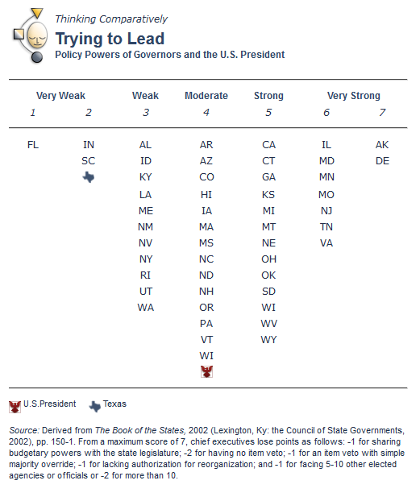
Assessment of Institutional Power Wielded by Governors
Max score = 7 pts
Deductions:
-1 if share budgetary
Powers
-2 for no item veto
-1 for item veto with
simple majority
override
-1 for lacking
authority to reorganize
-1 for having 5-10 other
elected officials in
executive
—OR—
-2 if >10 others
http://www.laits.utexas.edu/txp_media/html/exec/features/0400_01.html

Slide 23
Gubernatorial Power
Two components
  Institutional
    Given by state’s Constitution
    Five types
  Personal
    Varies with the person & circumstance

Slide 24
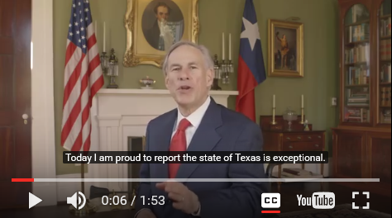
Gubernatorial Personal Power in Action
https://youtu.be/ahfXxhUDbXg

Slide 25
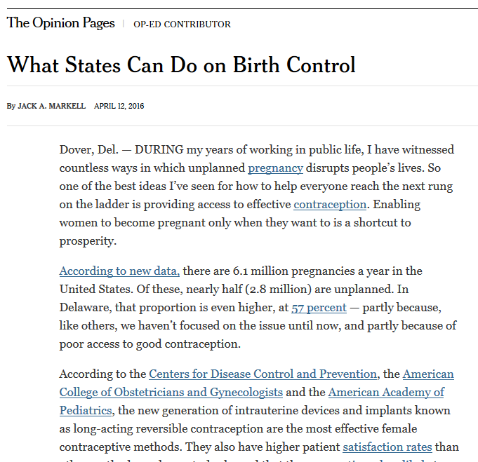
Personal Powers of Governors
What enables governors “to get stuff done” despite institutional limits
  Dependent on personality and political skills
  Informal and indirect
  Especially important for institutionally “weak” governorships, like in Texas
Win the de facto leadership role by using the media, public contact, and skillful diplomacy & persuasion
Teddy Roosevelt’s “bully pulpit”
http://www.nytimes.com/2016/04/12/opinion/what-states-can-do-on-birth-control.html?_r=0
google it!
Then-current
Governor of Delaware

Slide 26
Governors’ Institutional vs. Personal Powers
What kind of specific measures might be included in this aggregate measure of “personal power?”
…so no empirical relationship, but relative positions of states are still of interest

Slide 27
Practice Problems
…to begin mastering this material.
Complete instructions are in the Module 1 resource, How to Use Practice Problems to Prepare for Exams.
Don’t forget to do the…

